Slide 1

May 25, 2016
Machine Learning
- Introduction -
Hyoungsik Nam
Integrated Display Electronics & Algorithm (IDEA) Lab.
Kyung Hee University

Slide 2
What is Machine Learning?
A computer program is said to learn from experience E with respect to some class of tasks T and performance measure P, if its performance at tasks in T, as measured by P, improves with experience E.
-Machine Learning, 1997, McGraw-Hill, Tom M. Mitchell (CMU)
Big Data
100hr Video/min
(YouTube)
Automated
Data Analysis
1M Transactions/hr
= 2.5x10¹⁵ bytes
(Wall Mart)
Machine
Learning
Genomes of 1000s people. Each has a length of 3.8x10⁹ base pairs

Slide 3
Types of Machine Learning
Supervised Learning
To learn a mapping from inputs x to outputs y, given a labeled set of input-output pairs D = {(x_{i},y_{i})}_{i=1…N}.
Unsupervised Learning
To find “interesting patterns” in the data, given inputs, D = {(x_{i})}_{i=1…N}.
Knowledge discovery
Reinforcement Learning
To learn how to act or behave when given occasional reward or punishment signals.
For example, how a baby learns to walk.

Slide 4

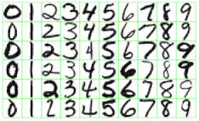
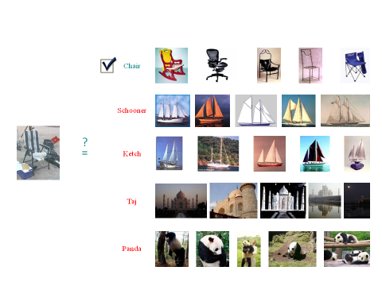
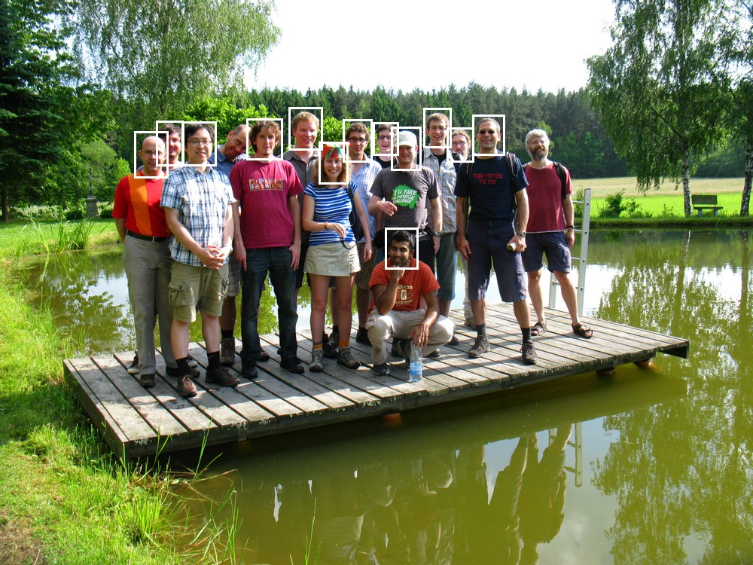
Supervised Learning Cases
Classification
Handwriting Recognition
Spam Filtering
Image Classification
Face Detection & Recognition

Slide 5
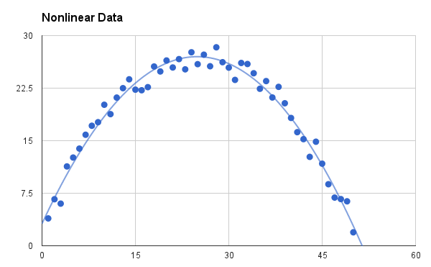
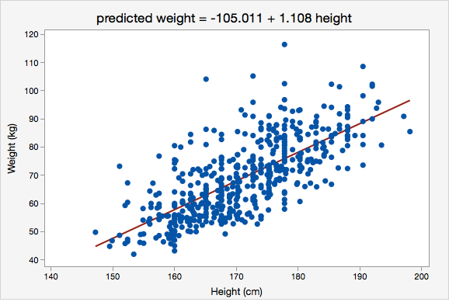
Supervised Learning Cases
Regression
Response variable is continuous.
Linear Regression
Polynomial Regression

Slide 6
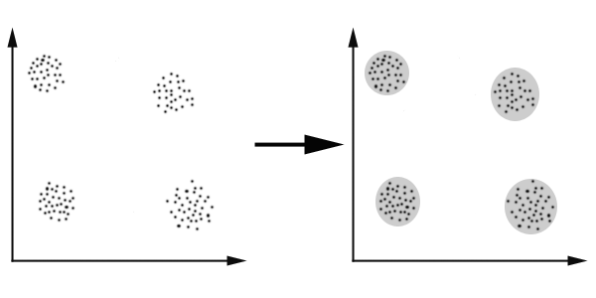
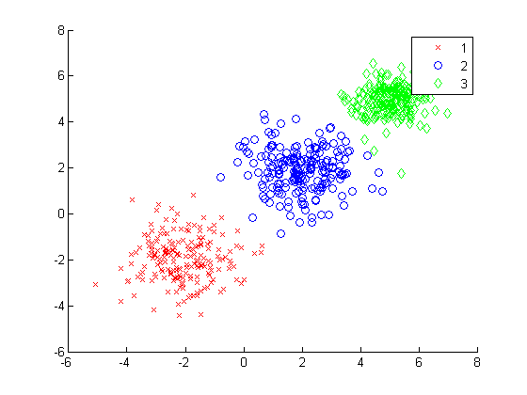
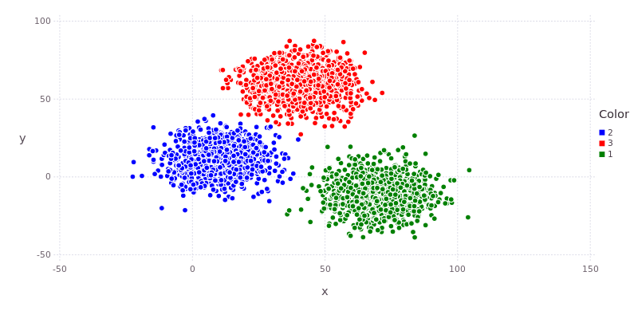
Unsupervised Learning Cases
Clustering

Slide 7
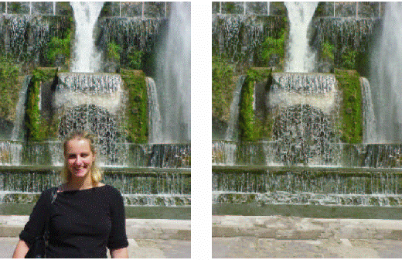
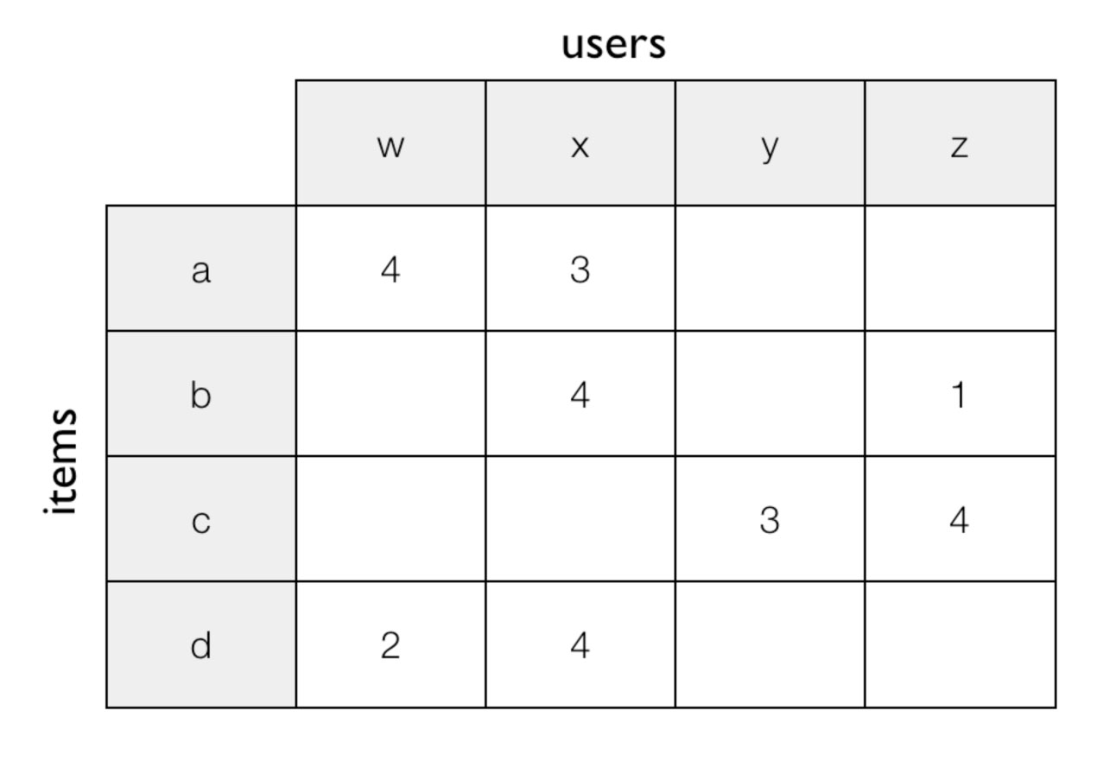
Unsupervised Learning Cases
Matrix Completion
Image Inpainting
Collaborative Filtering
Ex) BellKor’s Pragmatic Chaos in Netflix Prize

Slide 8
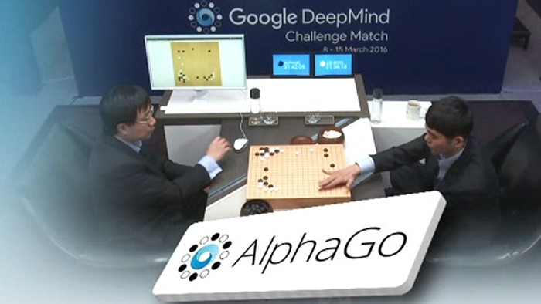
Reinforcement Learning Cases

Slide 9
Parametric vs. Non-parametric
We will be focusing on probabilistic models of the form p(y|x) or p(x).
Parametric model
The model has a fixed number of parameters.
Non-parametric model
The number of parameters grow with the amount of training data.
Ex) K-nearest neighbors (KNN)

Slide 10
Designing Learning System
Choosing Training Experience (Training Data)
It rests on the crucial assumption that the distribution of training examples is identical to the distribution of test examples.
Choosing Target Function
It determines what type of knowledge will be learned and how this will be used by the performance program.
Choosing Representation of Learned Function
The program will use a representation to describe the target function that it will learn.
Choosing Learning Algorithm

Slide 11
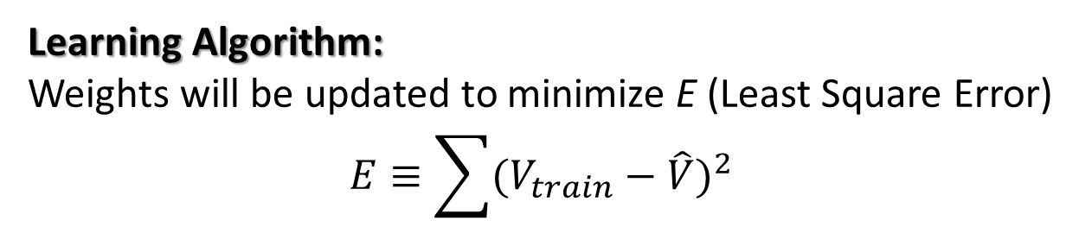
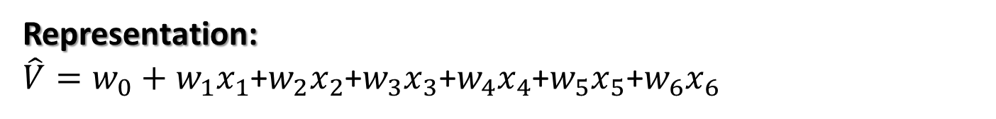
Designing Learning System (Example)
Task:
playing checkers
Performance Measure:
percent of games won in the world tournament.
Training Experience:
Games played against itself
Target Function:
Win -> V = 100, Lost -> V = -100, Draw -> V = 0
Representation:
$\hat{V}=w_{0}+w_{1}x_{1}$+$w_{2}x_{2}$+$w_{3}x_{3}$+$w_{4}x_{4}$+$w_{5}x_{5}$+$w_{6}x_{6}$
Learning Algorithm:
Weights will be updated to minimize E (Least Square Error)
$$E≡\sum{{(V_{train}−\hat{V})}^{2}}$$

